Slide 1
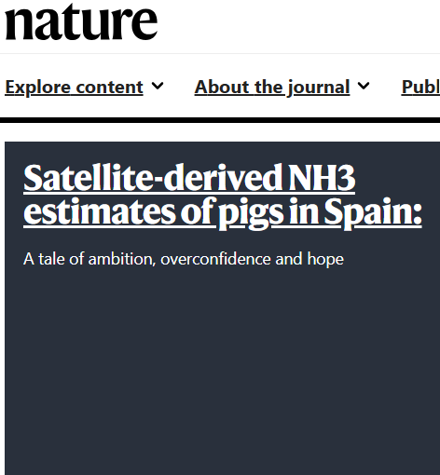


Clare, Claudia, Zhonghua, Varun and Mahmoud

Slide 2
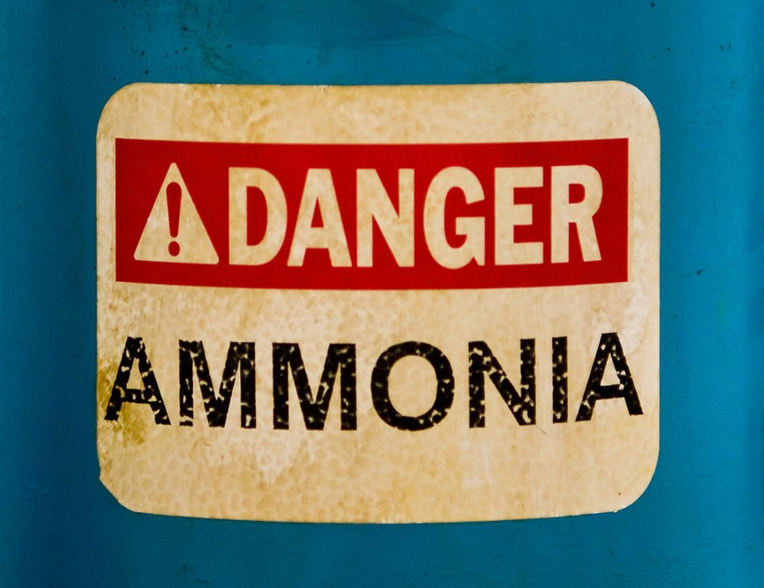
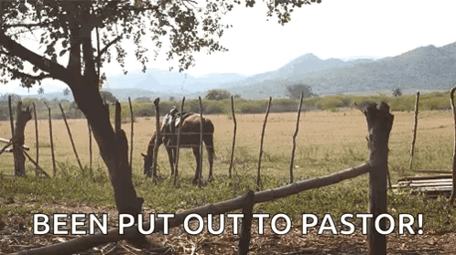
Research questions
Can we estimate ammonia deposition using satellite data?
Do these estimates suggested Impact on sensitive habitats in a study area?
Can we identify protected sites under threat from deposition in a study area?

Slide 3
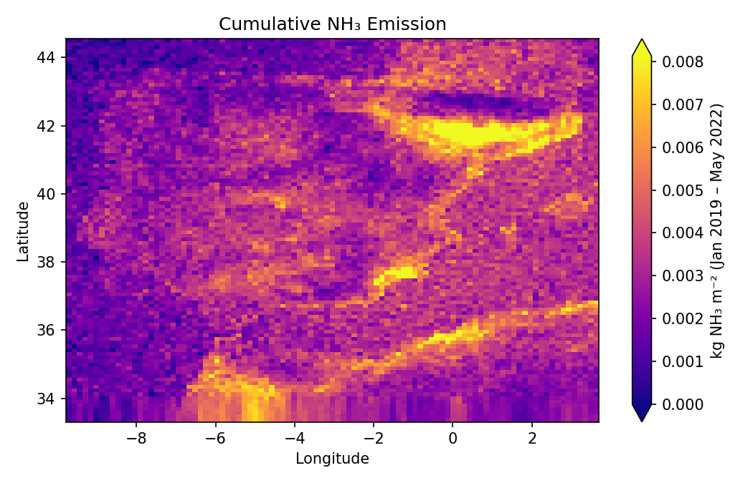
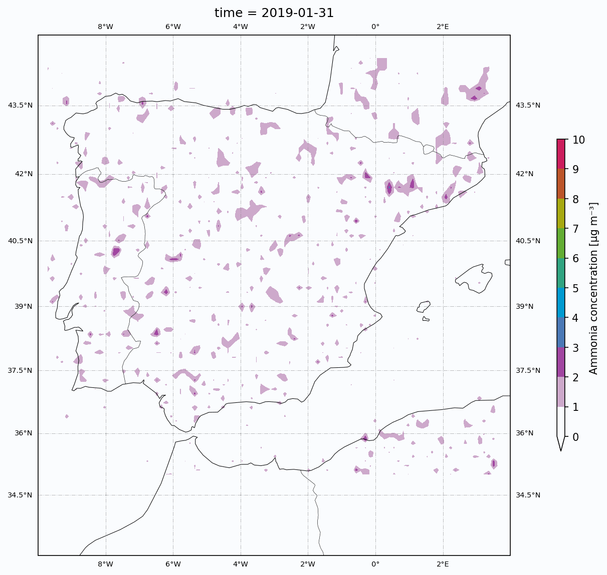
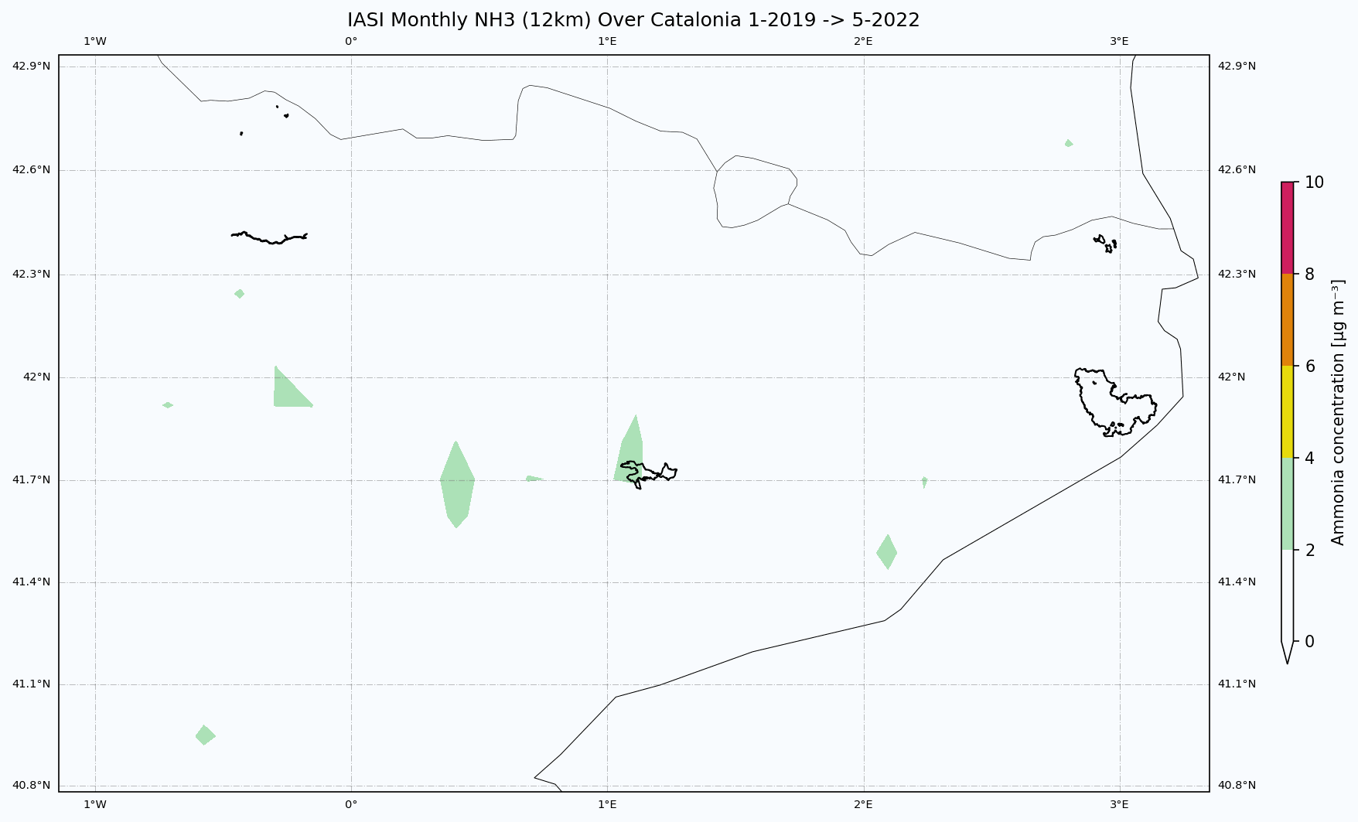
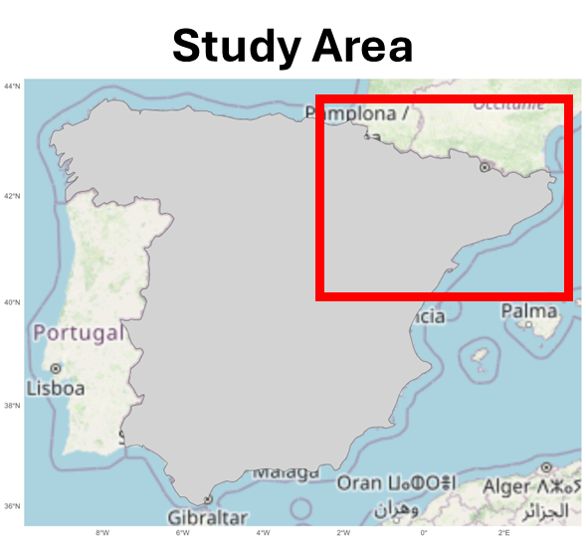
Study Area?
Notes:
Hotspot of emissions sound of the pyrenees in Catalonia
Cumulative ammonia emissions from Sum of monthly total IASI data dataset
Concentrated area in north-eastern Spain
Why?

Slide 4
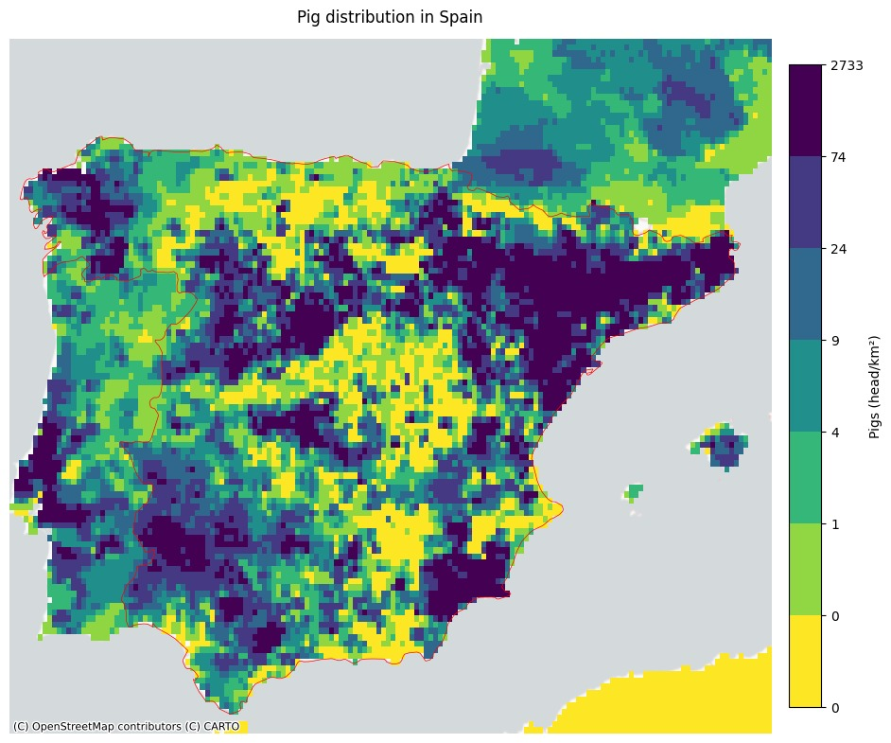
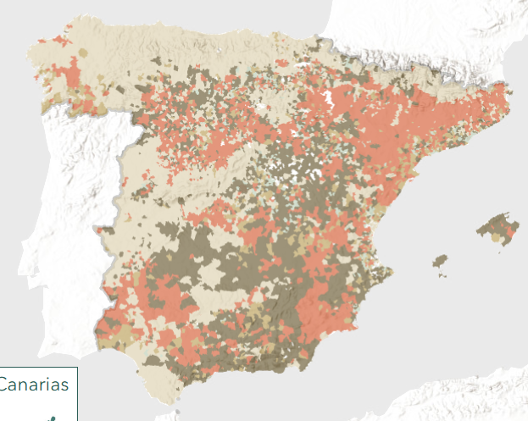

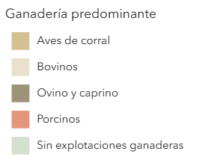
Pigs!
Data source: Institute of national statistics, 2020 Agricultural Census.
Agricultural Census 2020
Data source: FAO?

Slide 5


Datasets
Satellite data - IASI - monthly mean NH₃ Jan 2019 - May 2022
Sensitive/protected areas: Subset of Natura 2000 - Special Area of Conservation (SAC): Bogs, Marshes, Water fringed vegetation, Fens in Spain
Data- Era5 reanalysis data = monthly 2019:2022
Sentinel-2 - Atmospherically corrected L2a - NDVI
Notes:
Era5 Boundary layer height
Friction velocity (u*)
Wind speed and direction
Surface temperature (at 2m)
Dew point temperature (at 2m)
Surface roughness (z)
Total precipitation
Convective precipitation
Large scale precipitation
Total cloud cover

Slide 6

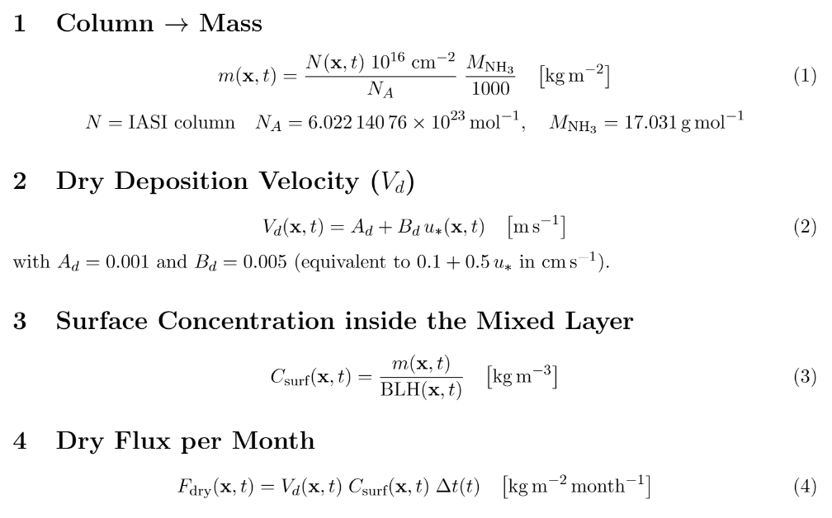
Method: Deposition modelling
PIGS-HOPE/nh3_work_flow.pdf at main · ZhonghuaM/PIGS-HOPE
Notes:
[1] Mohr, P. J., Taylor, B. N., & Newell, D. B. (2018). CODATA Recommended Values of the
Fundamental Physical Constants: 2018. Rev. Mod. Phys., 88(3).
[2] Wesely, M. L. (1989). Parameterization of Surface Resistances to Gaseous Dry Deposition.
Atmos. Environ., 23, 1293–1304.
[3] Seinfeld, J. H., & Pandis, S. N. (1998). Atmospheric Chemistry and Physics. Wiley.
[4] Zhang, L. et al. (2003). Dry Deposition Velocities for Sulphur Dioxide, Nitric Acid, Ammo-
nia. Atmos. Environ., 37, 1313–1342.
[5] Hersbach, H. et al. (2020). The ERA5 Global Reanalysis. QJRMS, 146, 1999–2049.
[6] Andronache, C. (2003). A Simple Parameterization for Below-Cloud Scavenging. Atmos.
Environ., 37, 4117–4123.
[7] Simpson, D. et al. (2019). EMEP MSC-W Model Description 2019. Norwegian Meteorological
Institute.
[8] Fosnacht, D. R., & Erler, A. (2017). A Fractional Raster Approach for Polygon Overlay.
Computers & Geosciences, 104, 12–20.

Slide 7
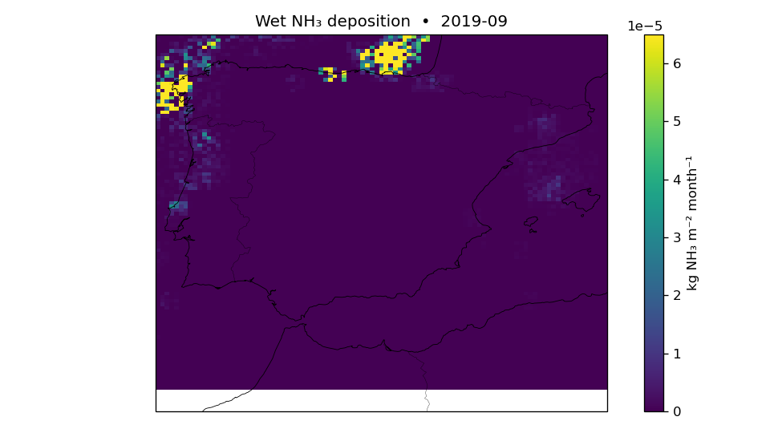
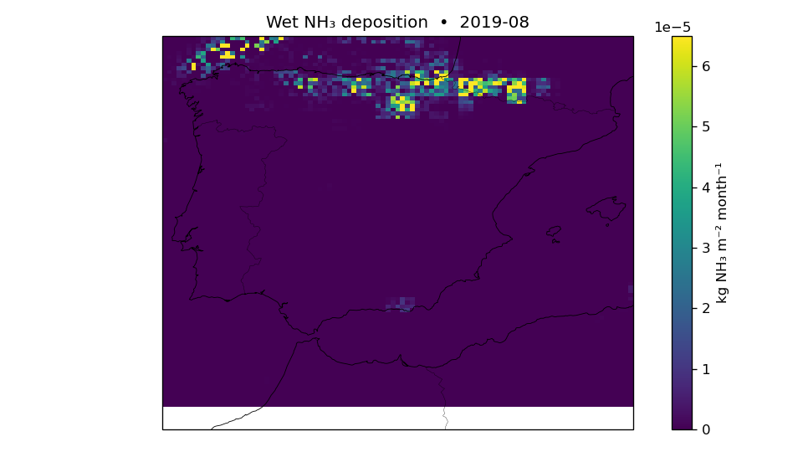
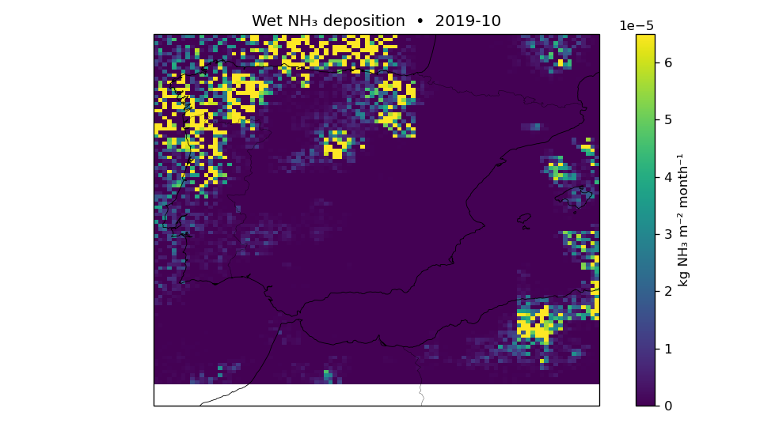
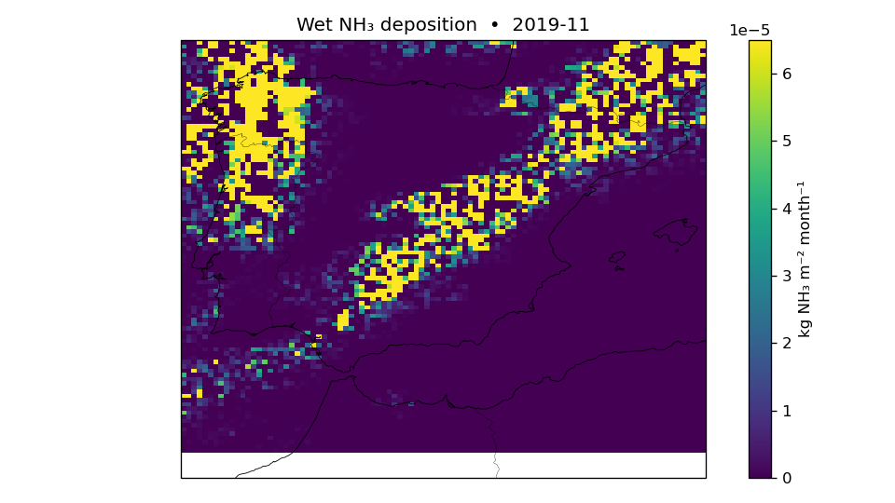
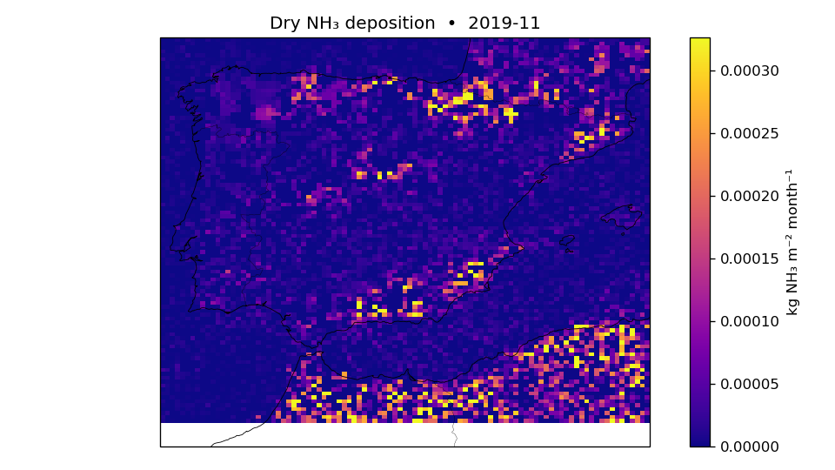
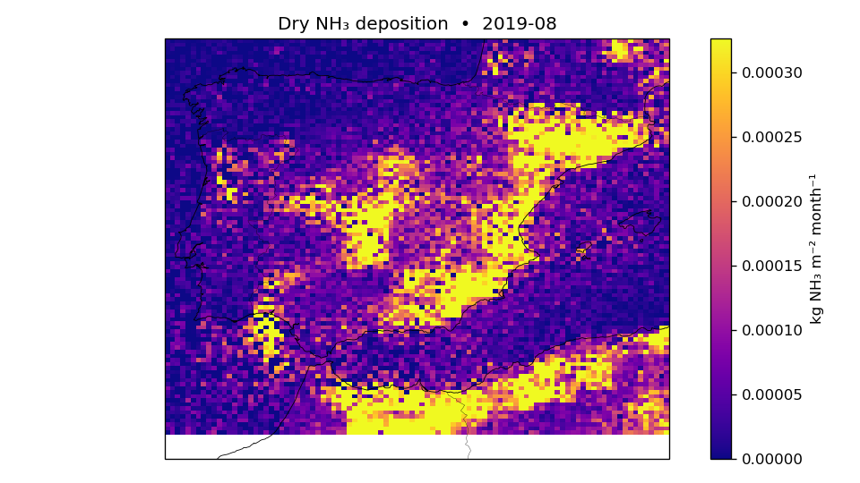
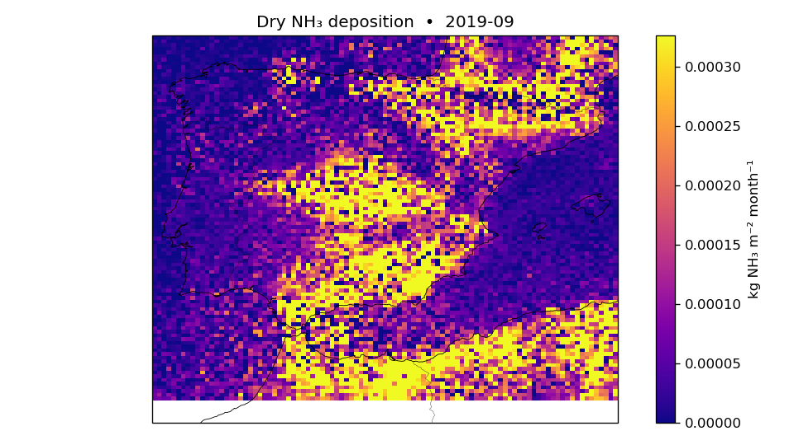
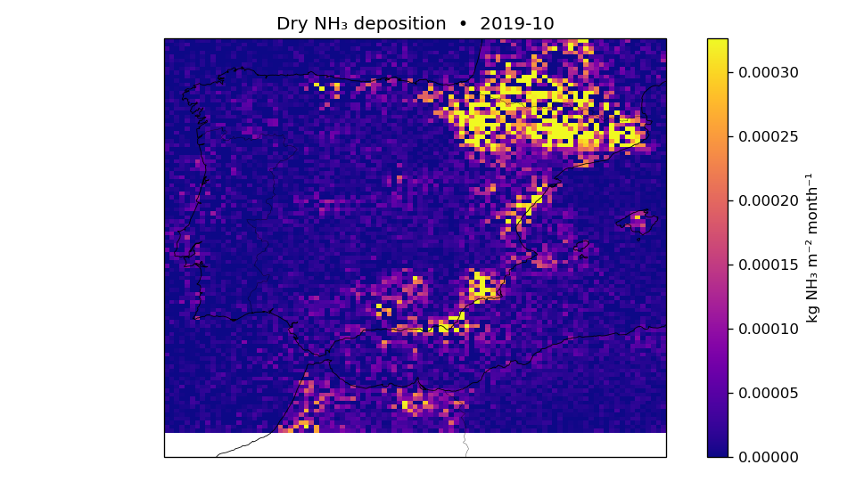
Results: Wet + dry = Total deposition
Notes:
Paper for nitrogen deposition validation: https://doi.org/10.1016/j.scitotenv.2014.03.112

Slide 8
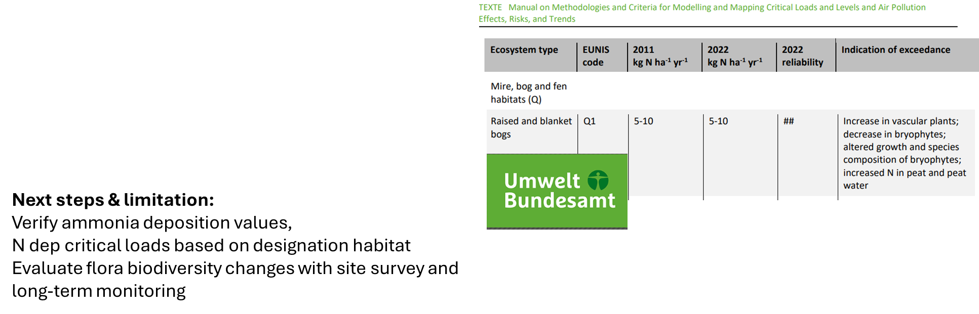
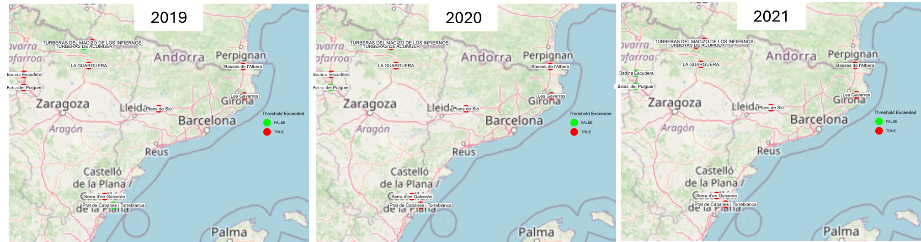
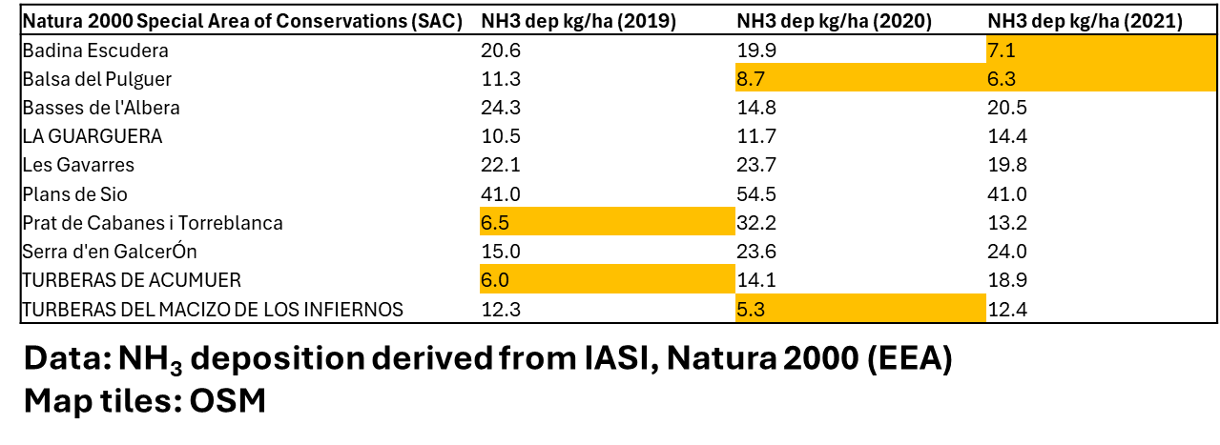

Slide 9
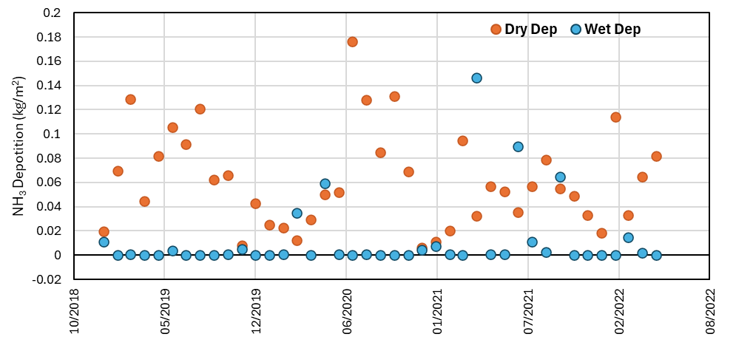
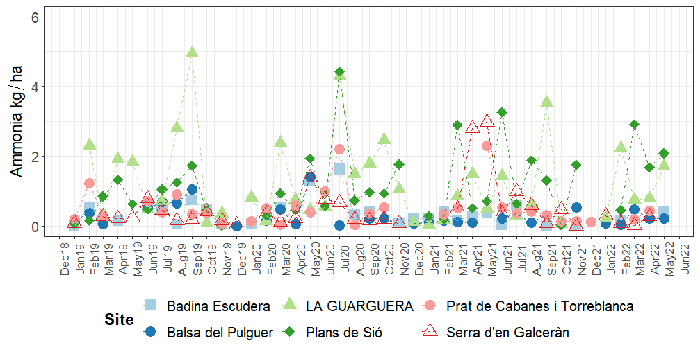
Results: Temporal Patterns

Slide 10
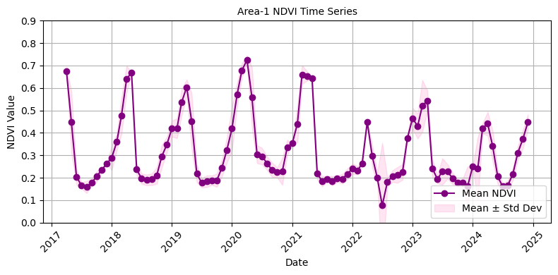
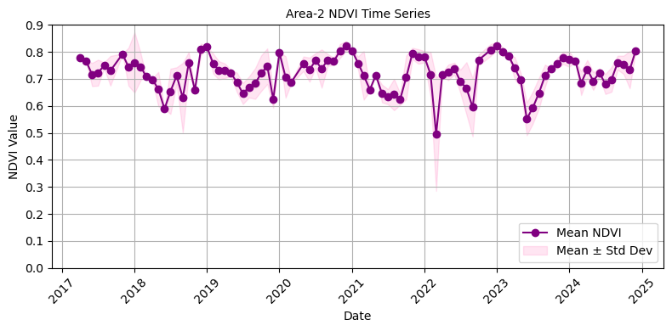
Pigs or no!

Slide 11
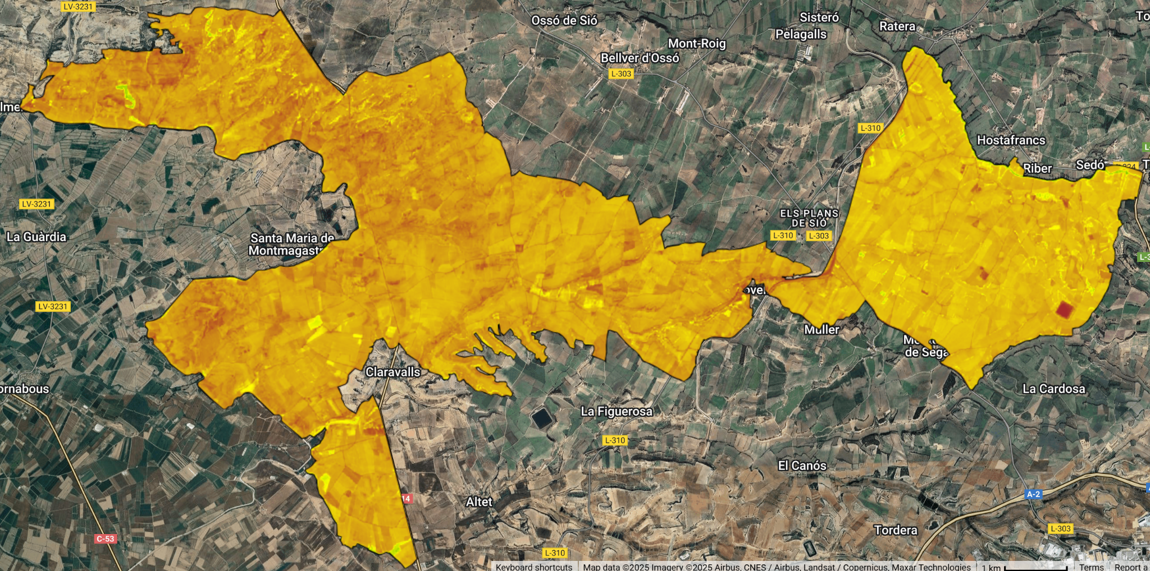
Or no!

Slide 12
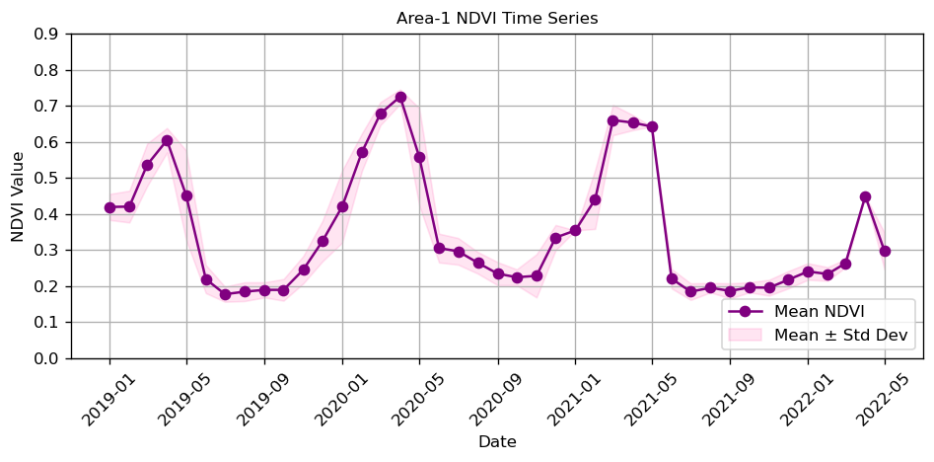
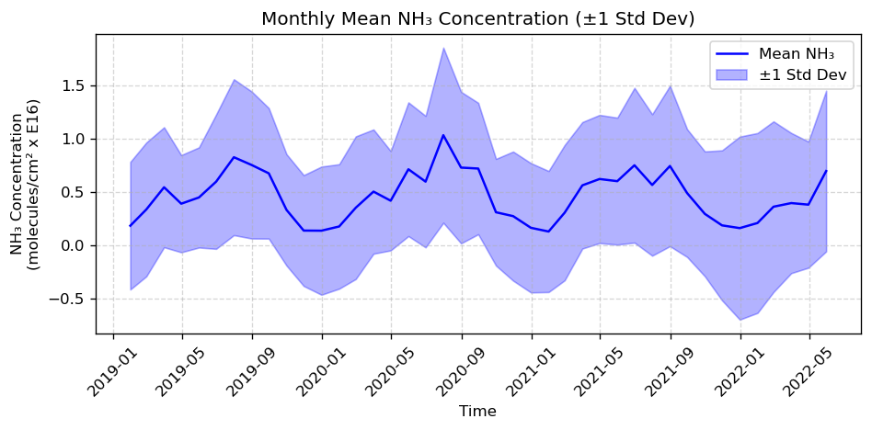
Fertilizers!

Slide 13


Conclusion:
"All models are wrong"
and so is this one….

Slide 14

Improvements for next time
Improved estimate of Vd value
Incorporate land cover components for a spatially variable Vd
LIDAR/Canopy height model of vegetation height
Validation or comparison against other data (e.g. local measurements)

